Slide 1


ENGLISH LEVEL B1 - II
Lesson 05
TALKING ABOUT UNIVERSITY LIFE

Slide 2

01
Talk to others about university life
ENGLISH LEVEL B1 - II

Slide 3

TALKING ABOUT UNIVERSITY LIFE
TALKING ABOUT UNIVERSITY LIFE CONTEXT
Listen to the conversation of Talking about University and answer the questions below:
1
Where can Kathryn find information about the rooms for her classes?
2
Why did Henry choose to specialize in general medicine?
3
What challenges did Kathryn face during her first year at university?
4
Why does Kathryn prefer studying at the library in the evening?
INSERTAR DIÁLOGO ALTISSIA

Slide 4
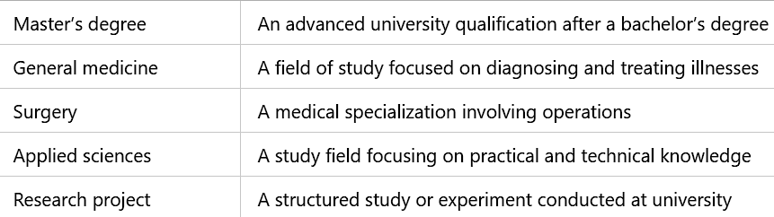
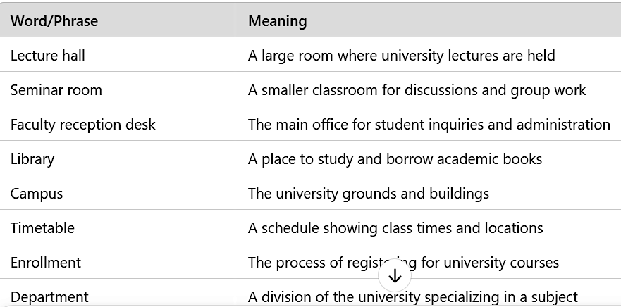
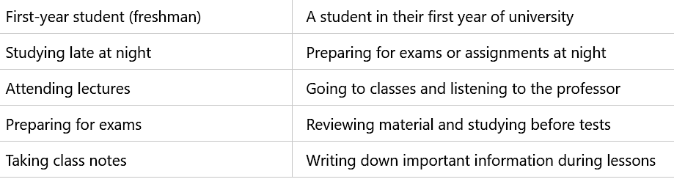
TALKING ABOUT UNIVERSITY LIFE
TALKING ABOUT UNIVERSITY LIFE CONTEXT
Fill in the blanks with the correct vocabulary word
I need to check my class schedule on the ____.
Many students prefer to study in the ____, especially before exams.
Kathryn went to the ____ to ask about her timetable.
Henry decided to specialize in ____.

Slide 5
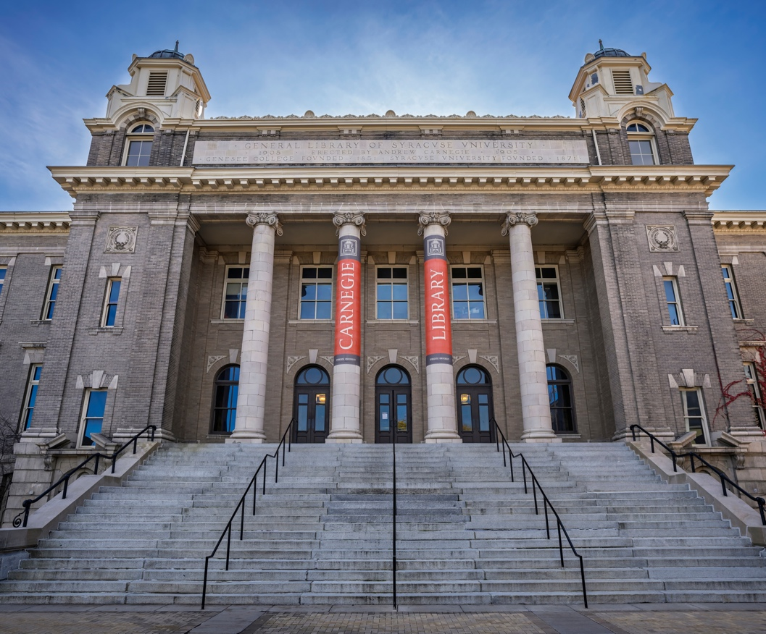
TALKING ABOUT UNIVERSITY LIFE
PAIR EXERCISE
Activity: University Life Discussion
Work with a partner and discuss:
1
What challenges did you face in your first year of university?
2
How do you usually prepare for exams?
3
Where do you prefer to study and why?
Role-play a conversation between two students discussing their academic plans and study habits.

Slide 6

TALKING ABOUT UNIVERSITY LIFE
CLASS DISCUSSION: REFLECT AND APPLY
Define some key vocabulary words
What is the difference between a seminar room and a lecture hall?
What are the biggest challenges students face in their first year at university?
Why is attending lectures important for university students?

